Slide 1


WOODRBOOK VALE VIRTUAL SPORTS DAY 2020

Slide 2
Welcome to the Woodbrook Vale Virtual Sports Day!
Monday 6th July until Friday 10th July, 3pm.
The PE department have put together a Virtual Sports Day for teachers and students to take part in at home!
Like any other sports day, you will be competing against all the other Tutor groups in your Year. We will award prizes for the best tutor group and we will also award individual prizes.
There are 7 challenges for you to take part in. Each slide will show a different challenge that will require little or no equipment. All are really easy so everyone can take part!
If you only want to take part in some challenges and not all then that is fine but just remember the more challenges you complete, the more points you will receive for your team!
Once you have completed the challenge, click on the link and this will take you to a Google Form. Simply log in, fill out the information, enter your score and submit the form. If for any reason this does not work, please email your PE teacher with your: Name, Year Group, Tutor Group and Score.
The PE department will be keeping track of scores and adding up points.
Staff entries are worth double points!

Slide 3
Number | Challenge | Google Form link
1 | How many kick ups? | https://forms.gle/wTeUsSwPayeTw8Ex7
2 | 1 minute sit ups | https://forms.gle/Sf2V3zjwZgbwe1om6
3 | Speed bounce | https://forms.gle/oH7jgVBb8JwjUrx9A
4 | 1.5 km run | https://forms.gle/jLsKWoMusWqrXNkQ7
5 | Burpees | https://forms.gle/VWfGk1Qc3s4jQzsQ7
6 | Standing long jump | https://forms.gle/tHMg7beHULGTWs9G6
7 | Stork stand balance | https://forms.gle/vc2Vn7cP7HtArMbJ9

Slide 4

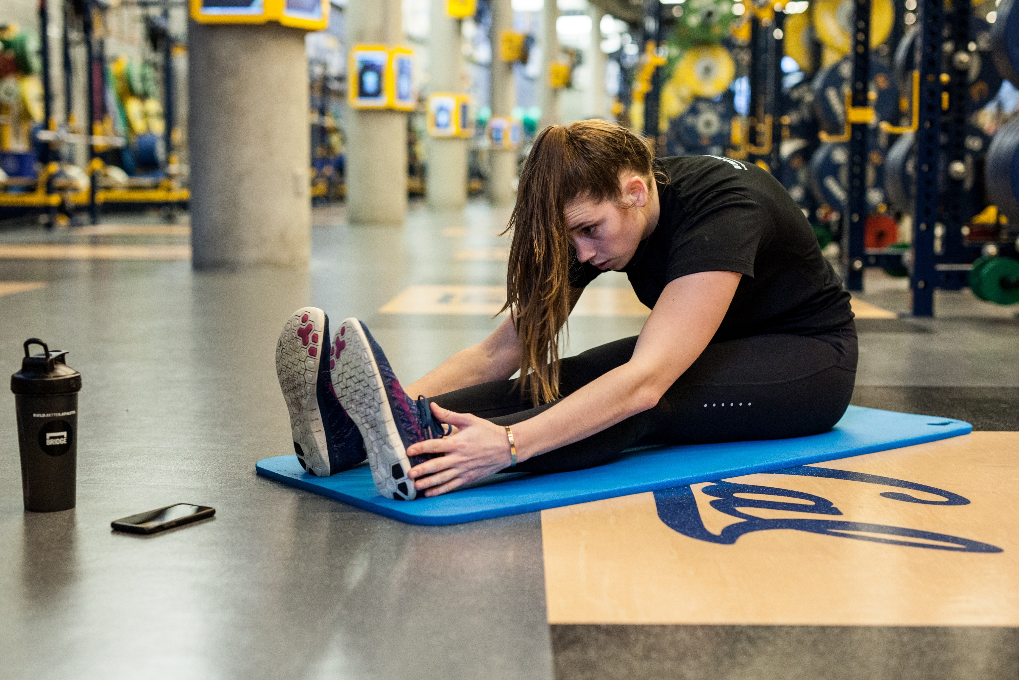
Before you take part in the physical challenges!
It is important you do the following before you take part:
A warm up – You have all been taught the importance of warming up in PE.
Make sure it includes a pulse raiser and stretches to warm your joints and muscles!
Check the environment around you
Do you have enough space? Do you need to clear some things away to make the space safer? Are there any wires/objects you could trip over?
Make sure you are wearing sensible footwear - We advise you wear trainers to protect your feet and give you the most grip!

Slide 5


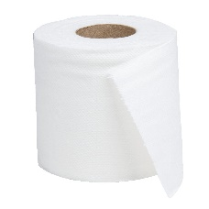

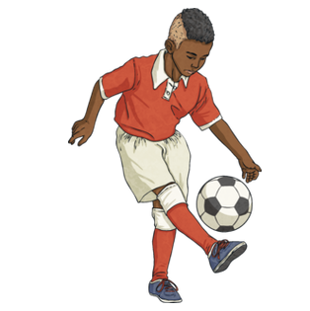
Challenge 1 – How many kick ups?
1. For this challenge you are going to need a ball – you could use a football, balloon, ball made out of socks or a toilet roll.
2. You need to count how many you do consecutively (without the object
touching the floor). This will be your score, keep trying to improve your score.
3. Final score x1 if you have used a balloon, x2 if you have used a football, x3 if you have used a toilet roll or socks e.g. Football total 57 will be 57x2= Total 114
TECHNIQUE
1. Kick the ball using your laces
2. Keep your eye on the ball
3. Maintain an upright posture
Click here to upload your score to the PE department!
https://forms.gle/wTeUsSwPayeTw8Ex7

Slide 6
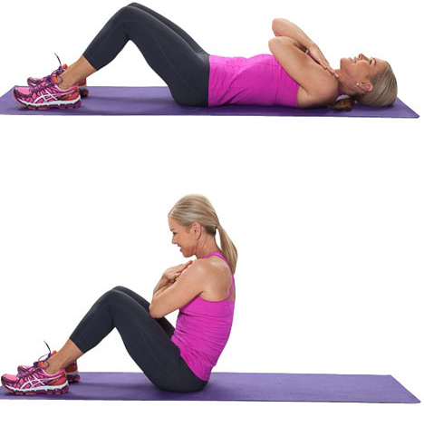
Challenge 2 – 1 minute Sit Ups
1. For this challenge you need an empty floor space. You may want to cushion your back with a resistance mat or towel
2. You have 1 minute to see how many sit ups you can do.
3. PLEASE NOTE: This is a sit up challenge and NOT a crunch challenge so you need to come all the way up to your knees!
TECHNIQUE
1. Lie on the floor with your knees bent and feet firmly on the ground.
2. Cross you arms or put your hands to the side of your head
3. Keep your core tight and come up all the way to your knees
Click here to upload your score to the PE department!
https://forms.gle/Sf2V3zjwZgbwe1om6

Slide 7
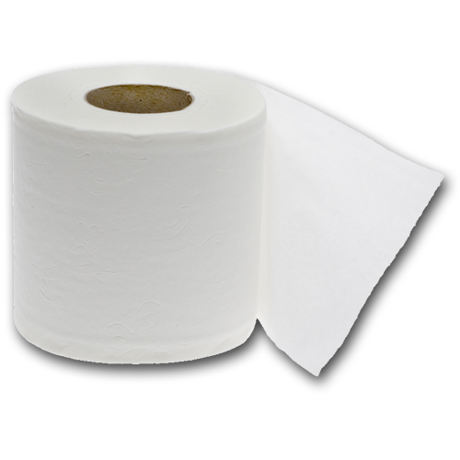
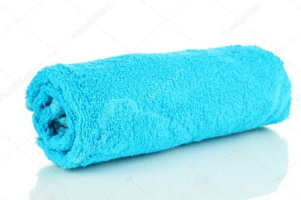
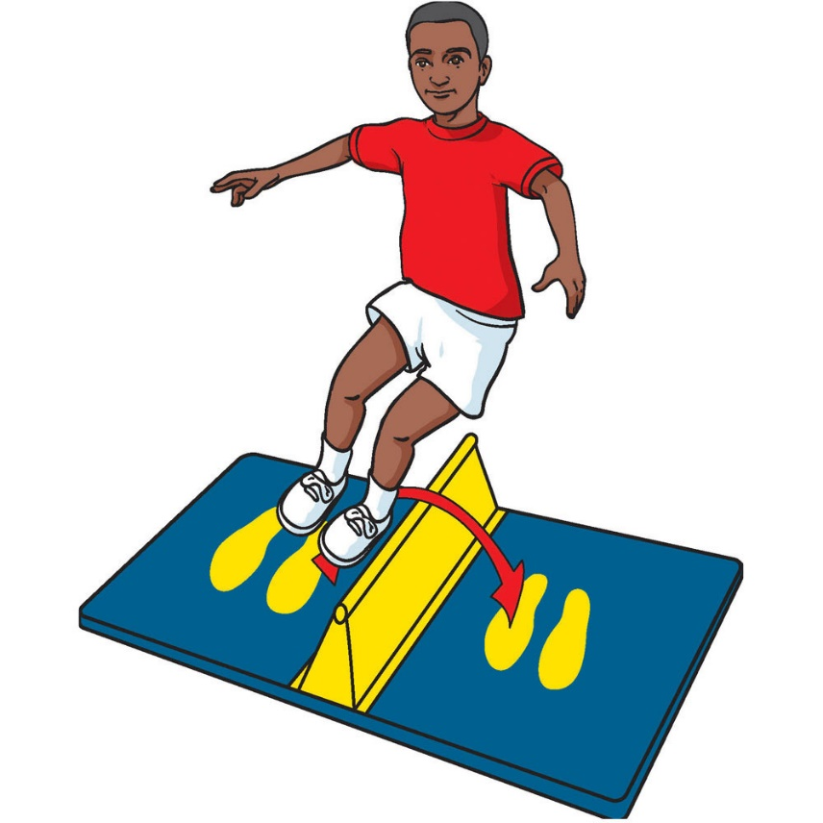
Challenge 3 – Speed Bounce
1. Create a speed bounce – this needs to be something you can jump over.
2. You could use a rolled up towel, a pillow or line of toilet rolls.
3. Time how many times you can jump over your object in 1 minute.
4. Each jump over the object counts as 1.
TECHNIQUE
1. It is a two footed jump – 2 feet to 2 feet
2. Bring feet as high as possible
3. Look at your feet for guidance
4. Must jump over the object and try not to touch it
Click here to upload your score to the PE department!
https://forms.gle/oH7jgVBb8JwjUrx9A

Slide 8
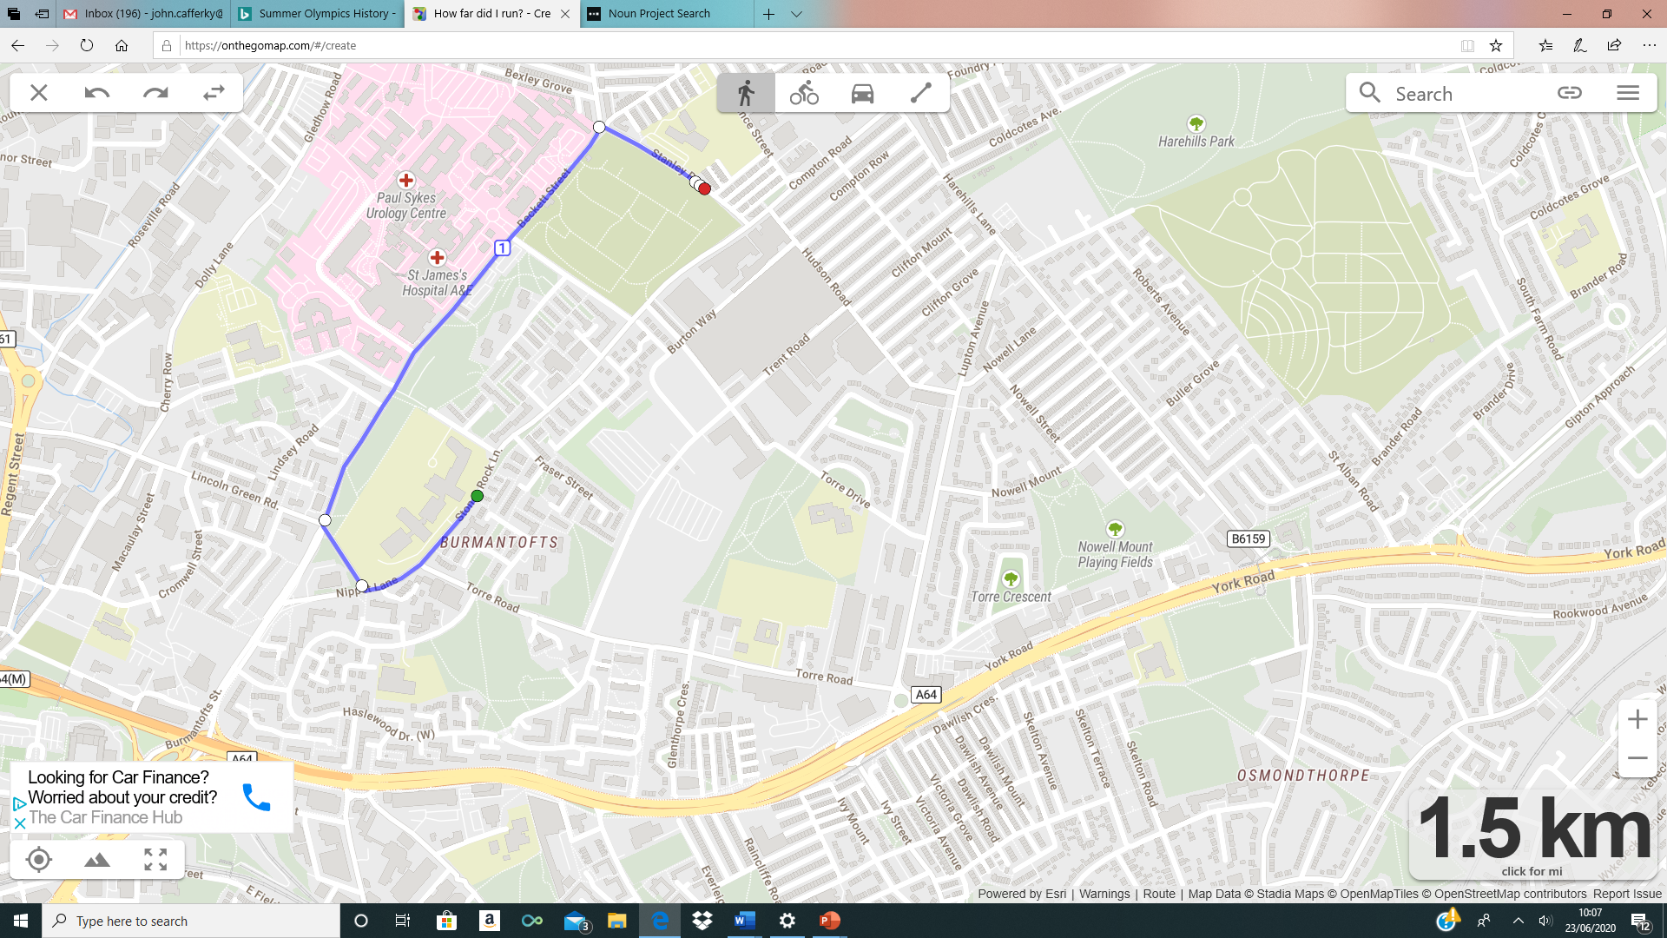
Challenge 4 – 1.5 km Run
1. Measure a 1.5km route near your house using https://onthegomap.com/#/create . Avoid routes where you have to cross roads, paths in local parks would be great for this. Make sure you choose a flat course.
2. If you only have a stop watch, walk for 10-12 minutes (most people cover 1.5 km in this time), then time how long it takes you to run back to your original starting position.
3. Submit how long it took you in minutes and seconds (min:seconds)
TECHNIQUE
1. Keep a steady and consistent pace
Click here to upload your score to the PE department!
https://forms.gle/jLsKWoMusWqrXNkQ7

Slide 9
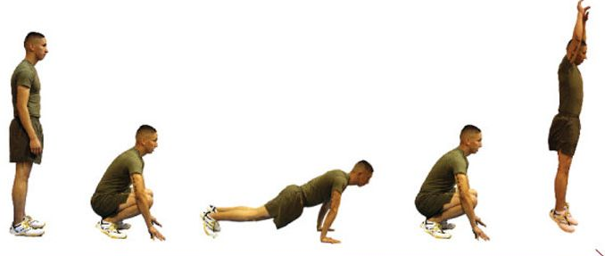
Challenge 5 – Burpees
1. For this challenge you need an empty floor space and a positive mind set as this challenge is a killer!
2. Your challenge is to see how many burpees you can do in 1 minute.
3. You must do a complete burpee (shown below) for it to count as 1. No cheating!
TECHNIQUE
1. Start standing up
2. Jump down to the floor in a tuck position
3. Kick your legs out into a press up position
4. Bring your legs back into a tuck position
5. Jump up and start again
Click here to upload your score to the PE department!
https://forms.gle/VWfGk1Qc3s4jQzsQ7

Slide 10
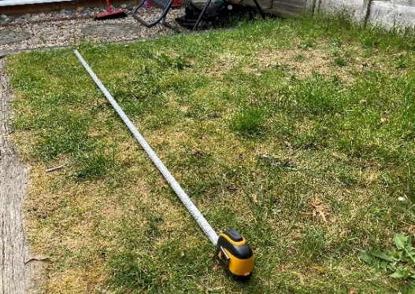
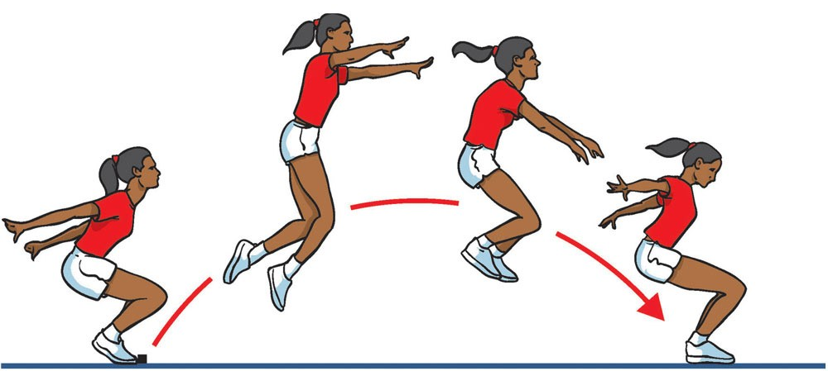
Challenge 6 – Standing Long Jump
1. Find a tape measure and set it up anywhere in your house or garden (as seen below in the photo)
2. Create a start line. This could be a line of pegs, shoe, towel or item of clothing
3. You have three attempts to see how far you can perform a STANDING long jump
then upload your best score.
TECHNIQUE
1. Stand with both feet shoulder width apart, parallel to the start line.
2. Squat deeply and swing your arms backwards.
3. Jump from 2 feet and land on 2 feet.
4. Measure from behind your heal.
Click here to upload your score to the PE department!
https://forms.gle/tHMg7beHULGTWs9G6

Slide 11
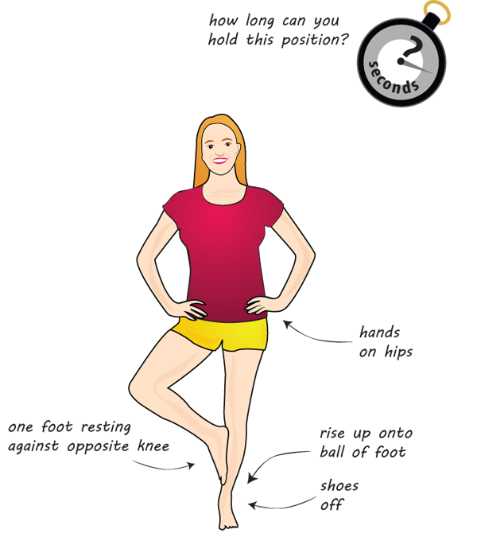
Challenge 7 – Stork Stand Balance
1. Create the Stork Stand balance position shown below
2. Time how long you can maintain this position until you become imbalanced and fall over
3. Whatever time you get to, will be your score.
TECHNIQUE
1. Stand with hands on hips
2. Place the sole of one foot against the side of the kneecap on the other leg
3. Look straight ahead and focus on one point
Click here to upload your score to the PE department!
https://forms.gle/vc2Vn7cP7HtArMbJ9

Slide 12
How points will be awarded.
The maximum points for winning each event will be 10 Points.
The following applies for every challenge in each year group.
1st = 10 points
2nd = 8 points
3rd = 6 points
4th = 4 points
5th = 2 points
All other entrants will receive 1 point.
Remember we will also award individual prizes.
Thanks to Aldridge School for their idea.

